Slide 1
Basic Compiler Functions
Grammars
Lexical Analysis
Syntactic Analysis
Code Generation

Slide 2
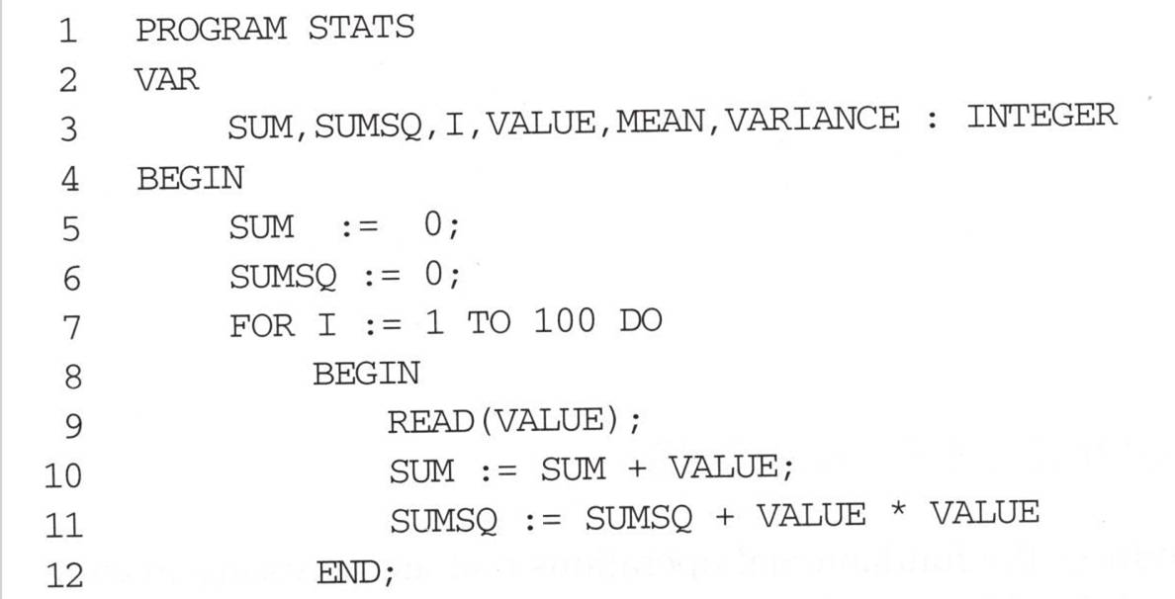
High-Level Programming Language
A high-level programming language is described in terms of a grammar, which specifies the syntax of legal statements.
  An assignment statement:
    a variable name + an assignment operator + an expression

Slide 3
Compiler
Compilation: matching statements (written by programmers) to structures (defined by the grammar) and generating the appropriate object code
  Lexical analysis (scanning)
    Scanning the source statement, recognizing and classifying the various tokens, including keywords, variable names, data types, operators, etc.
  Syntactic analysis (parsing)
    Recognizing each statement as some language construct described by the grammar
  Semantics (code generation)
    Generation of the object code

Slide 4
Grammars
A grammar is a formal description of the syntax.
BNF (Backus-Naur Form):
  A simple and widely used notations for writing grammars introduced by John Backus and Peter Naur in about 1960.
  Meta-symbols of BNF:
    ::= "is defined as"
    | "or"
    < > angle brackets used to surround non-terminal symbols
  A BNF rule defining a nonterminal has the form: nonterminal ::= sequence_of_alternatives consisting of strings of terminals (tokens) or nonterminals separated by the meta-symbol |

Slide 5
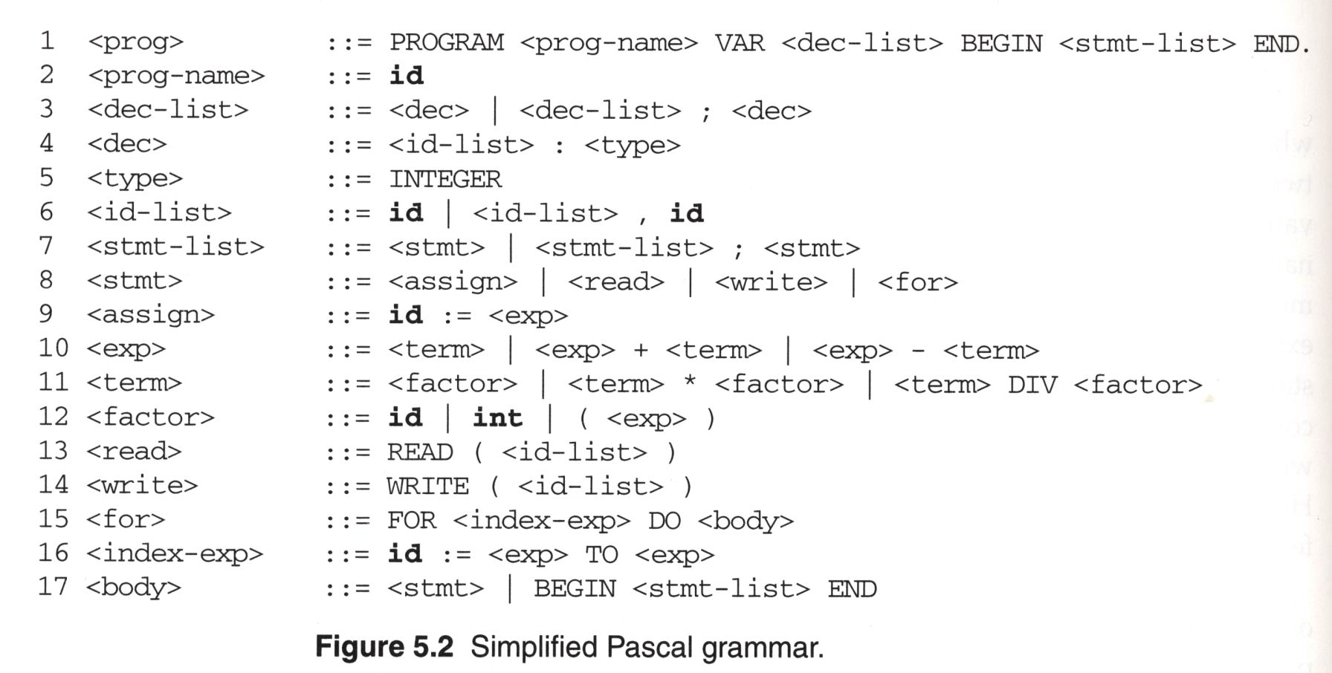
Simplified Pascal Grammar
Recursive rule

Slide 6
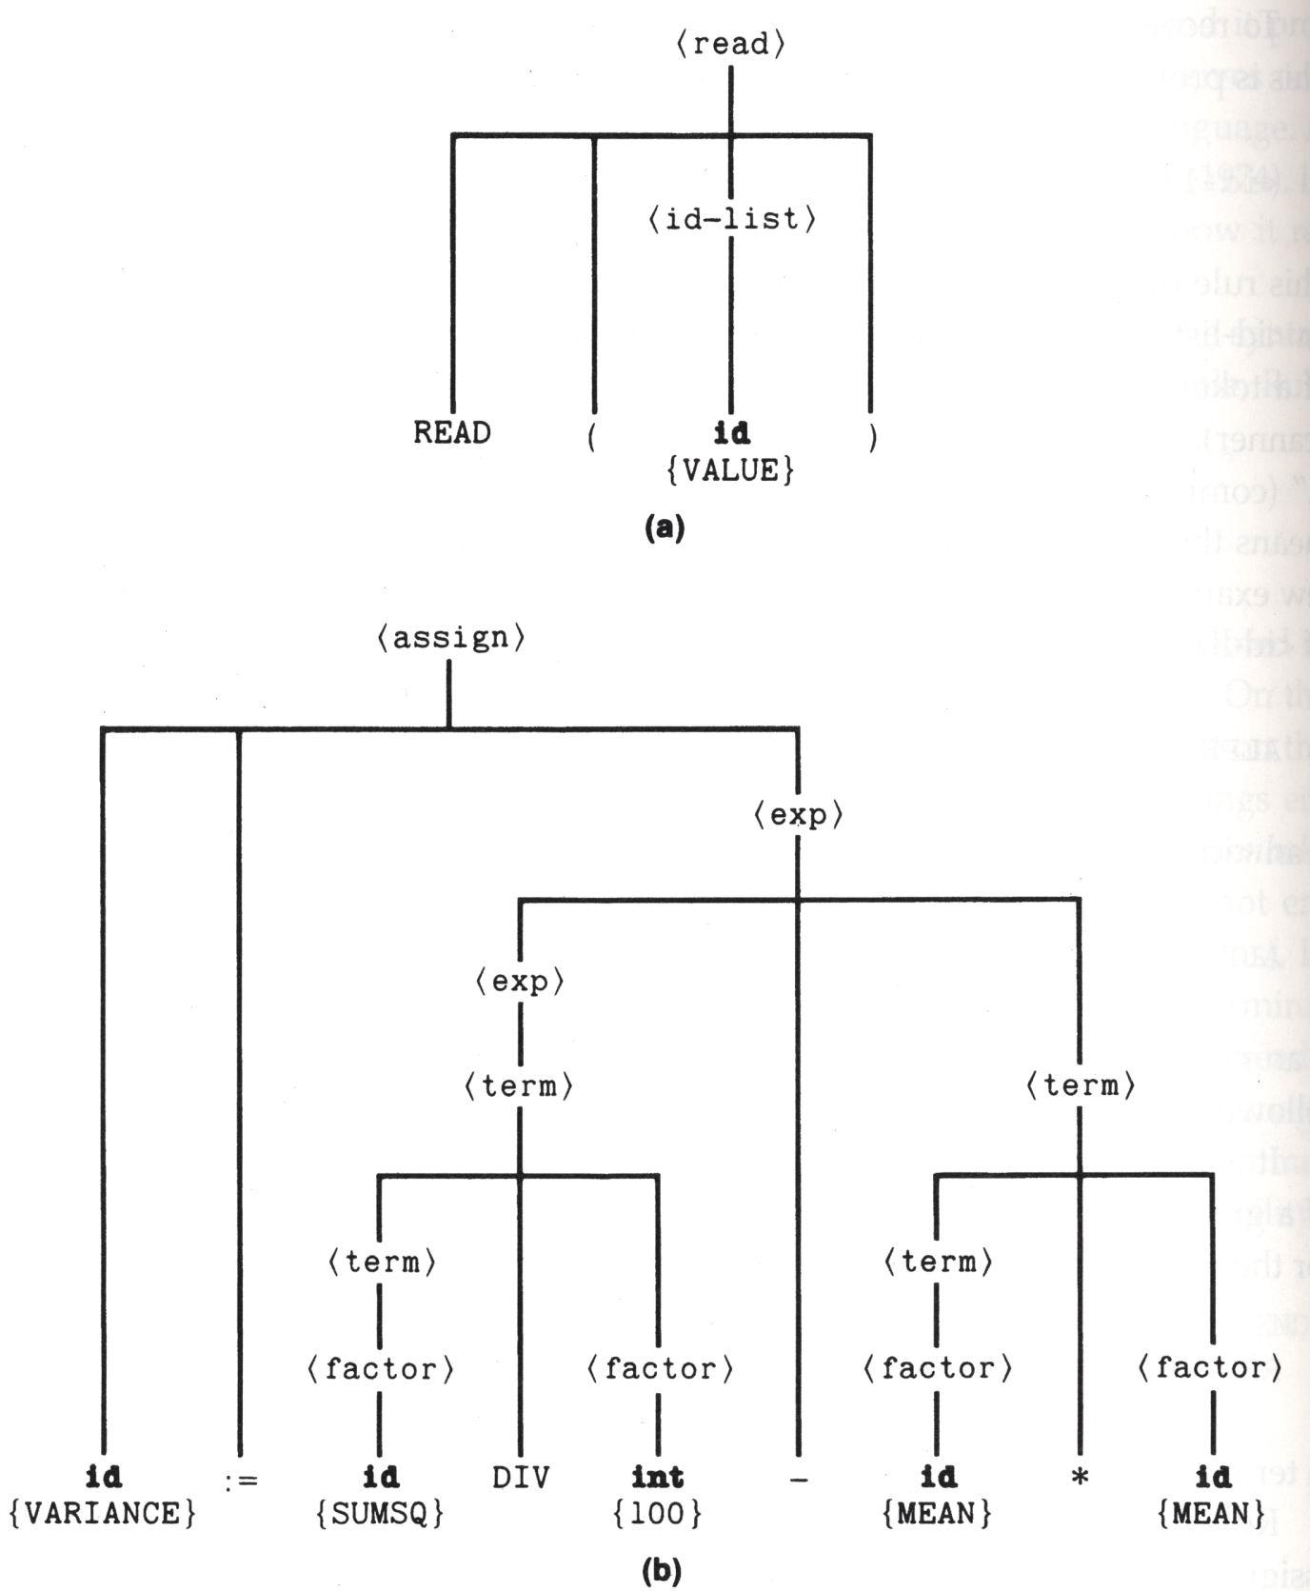
Parse Tree
(Syntax Tree)
READ(VALUE)
VARIANCE:=SUMSQ DIV 100
– MEAN*MEAN
The multiplication and division precede the addition and subtraction

Slide 7
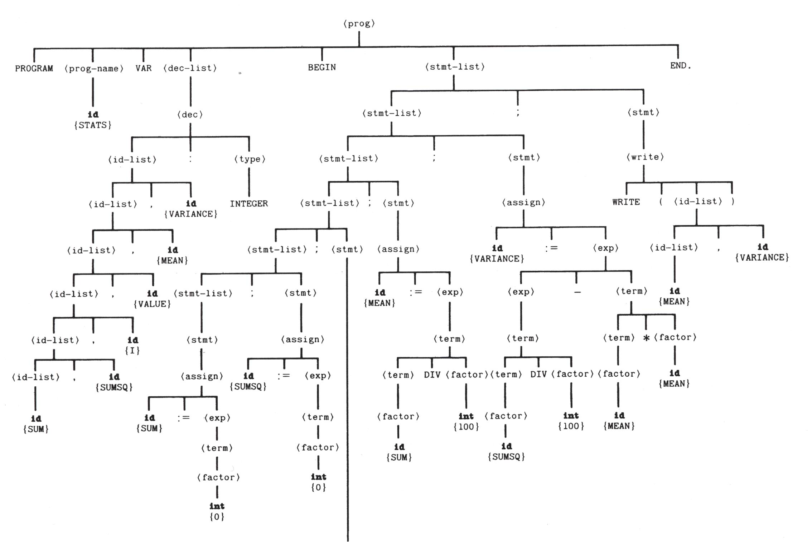
Parse Tree

Slide 8
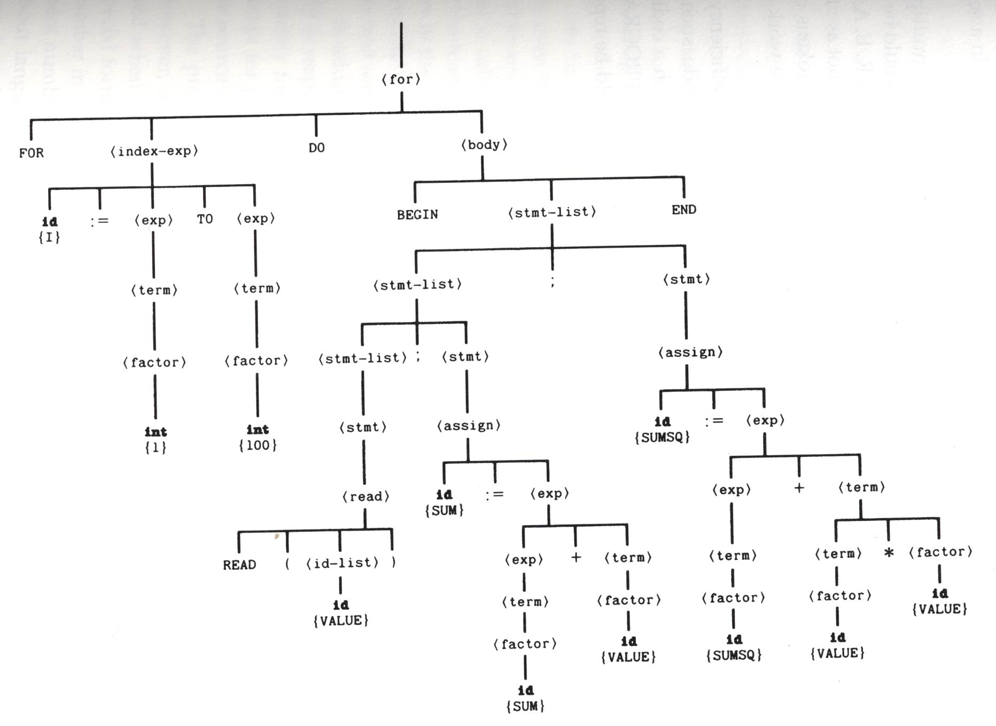
Parse Tree

Slide 9
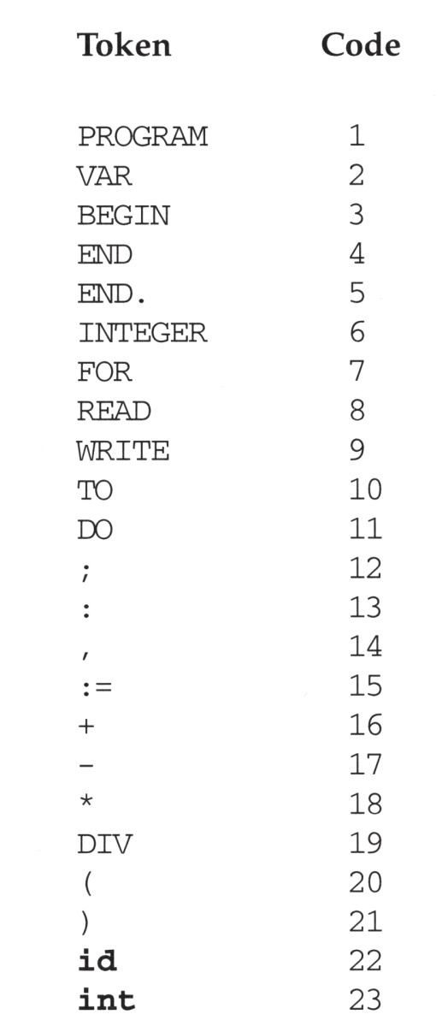
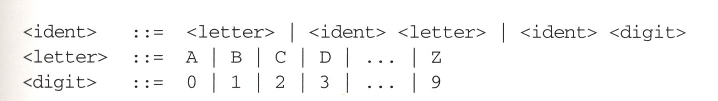
Lexical Analysis
Tokens might be defined by grammar rules to be recognized by the parser:
For better efficiency, a scanner can be used instead to recognize and output the tokens in a sequence represented by fixed-length codes and the associated token specifiers.

Slide 10
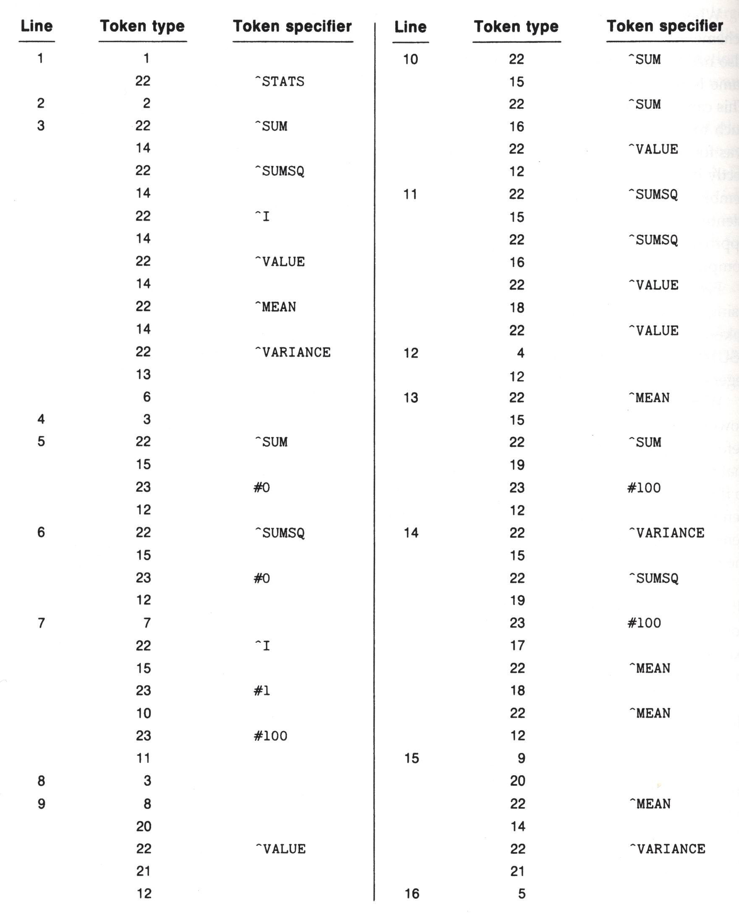
Lexical
Scan

Slide 11
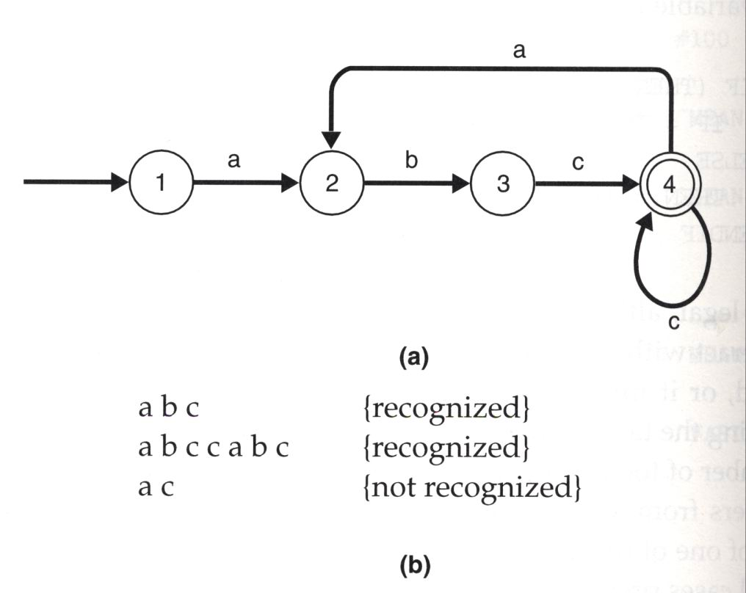
Modeling Scanners as Finite Automata
Tokens can often be recognized by a finite automaton, which consists of
  A finite set of states (including a starting state and one or more final states)
  A set of transtitions from one state to another

Slide 12
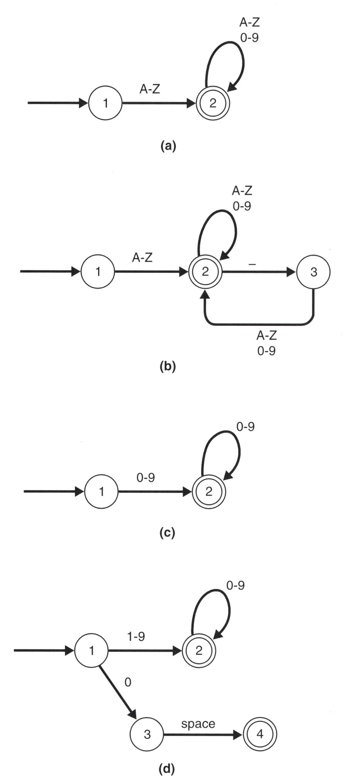
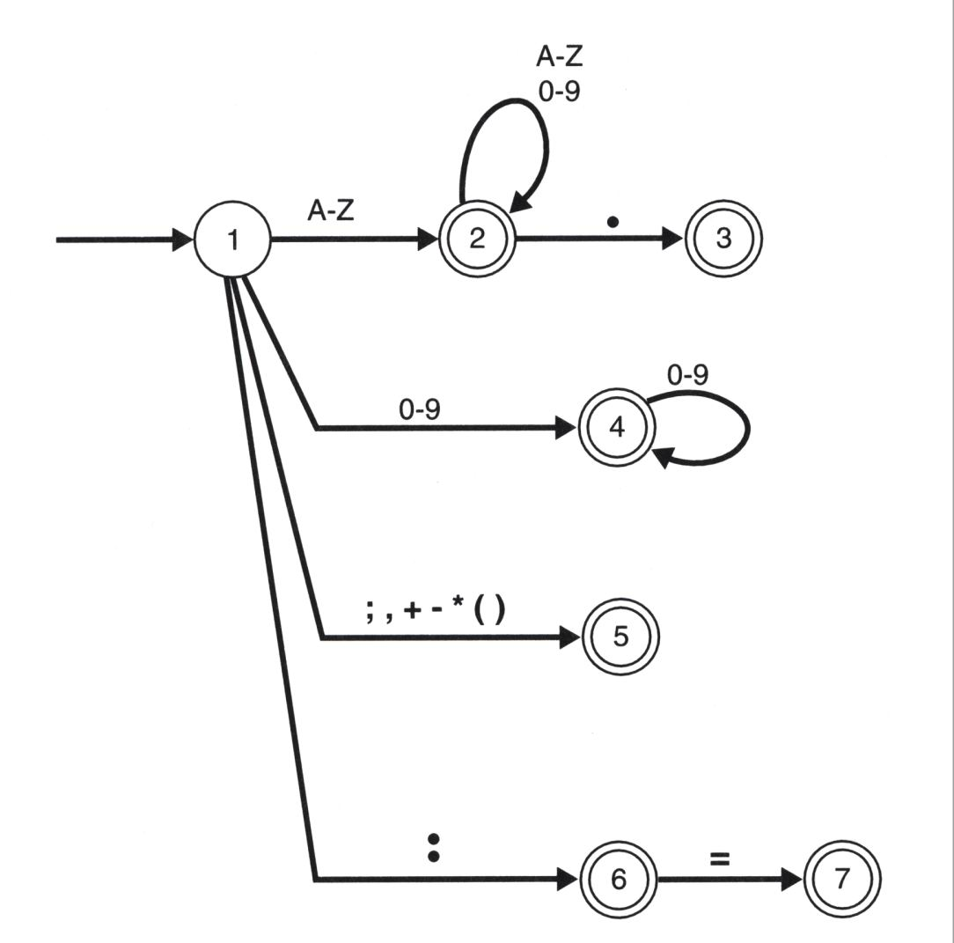
Finite Automata for Typical Tokens

Slide 13
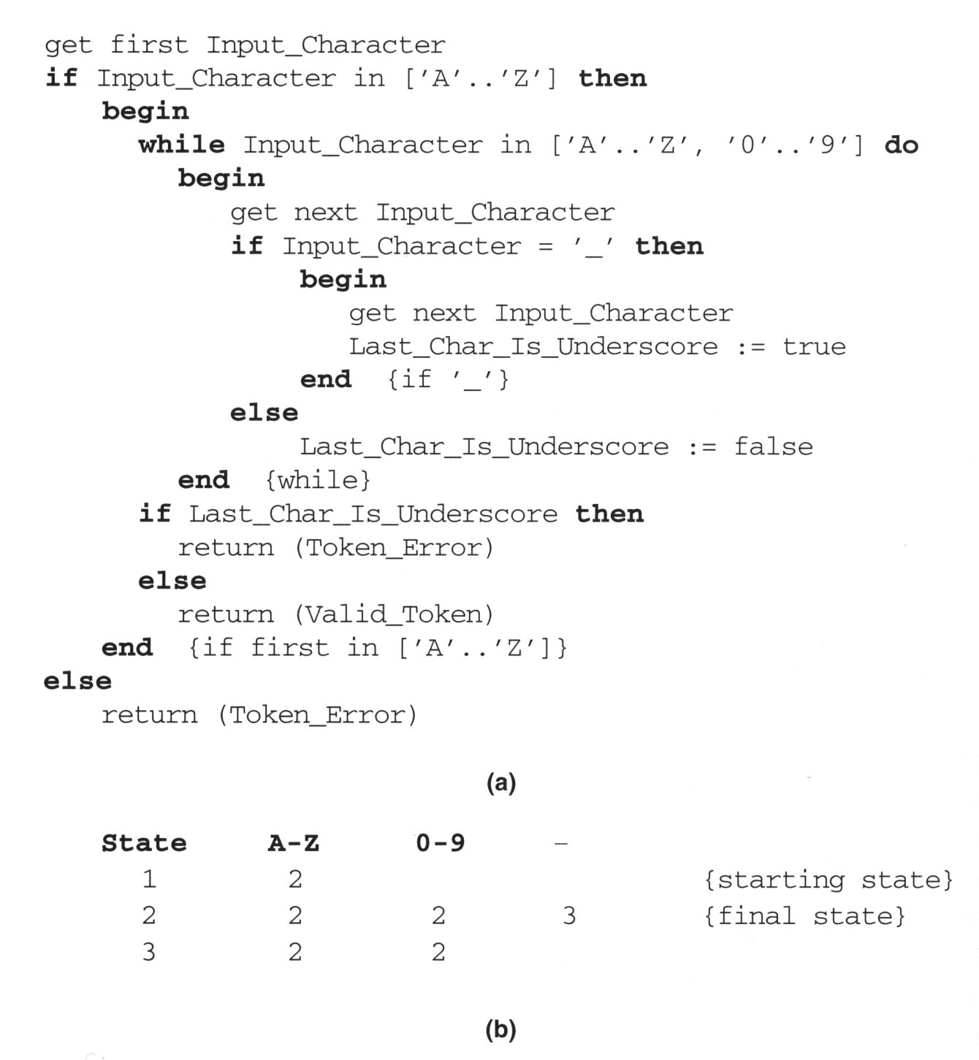
Token Recognition Algorithm

